Slide 1
Living It Out Together
Mark 2:1-12

Slide 2

If you were stuck and needed help, who's the first person you'd call?

Slide 3
Mark 2:1-12
Bible Reading

Slide 4
Imagine

Slide 5
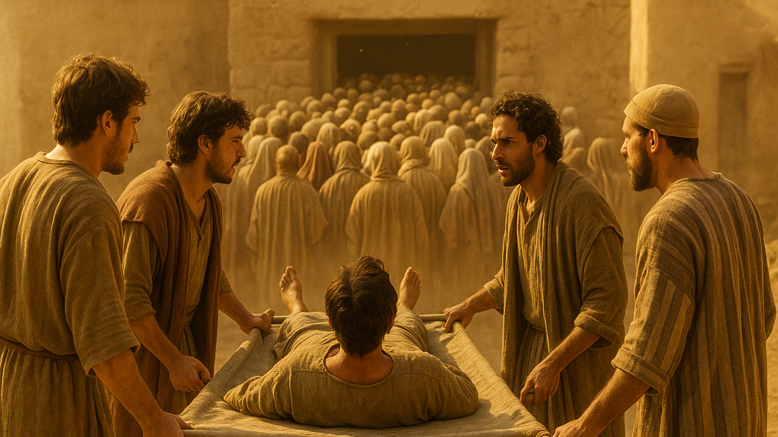

Slide 6
Exploring the Passage
Imagine you're the paralyzed man. You've been stuck on this mat for years. Your four friends show up one day and say, 'We're taking you to Jesus.' What are you thinking? Hopeful? Embarrassed that you need to be carried? Scared to get your hopes up again?

Slide 7
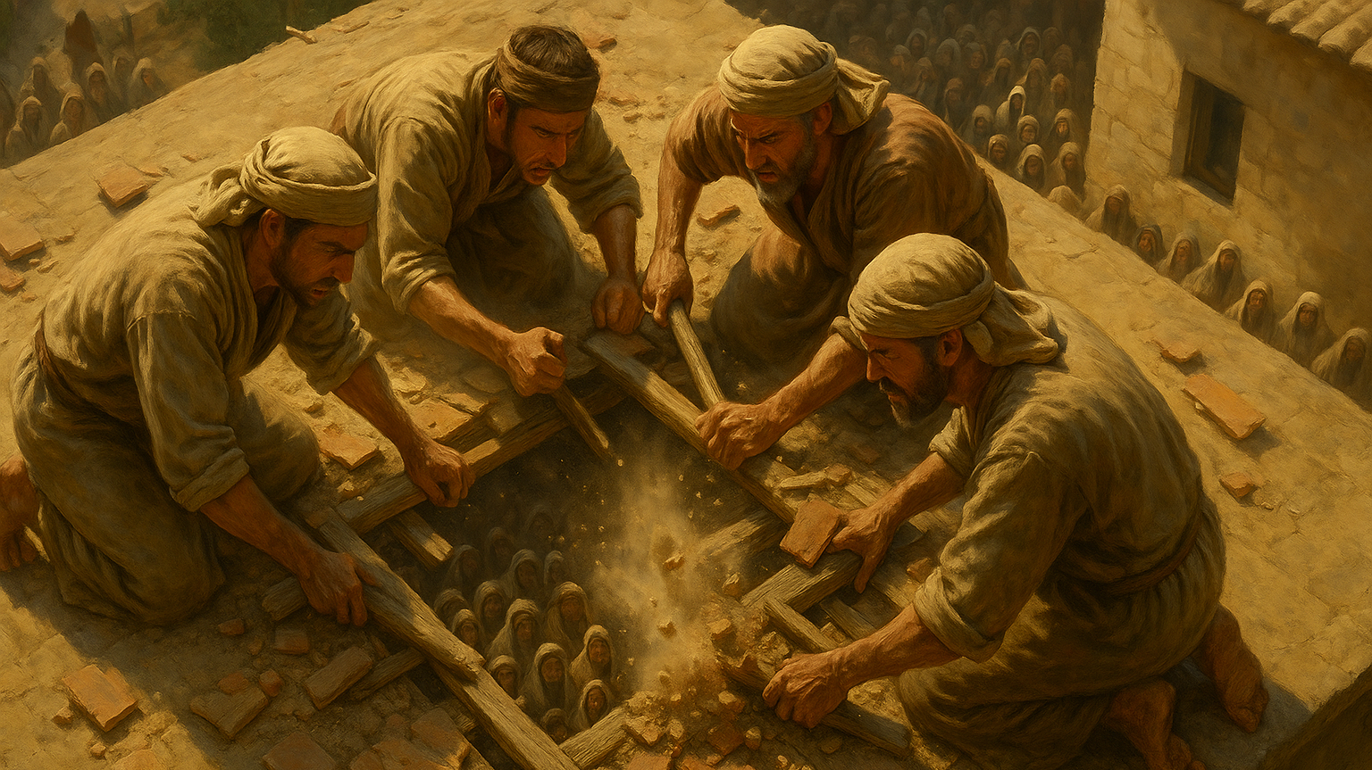

Slide 8
Exploring the Passage
You're up on the roof now, digging through someone's ceiling - tiles and dust falling on people below. The homeowner is probably furious. People are yelling at you. Your friend on the mat is probably mortified. Why don't you stop? What keeps you going?

Slide 9
Exploring the Passage
When the man walks out carrying his own mat, who do you think he goes to first? Jesus? Or his four friends who literally tore through a roof for him?

Slide 10
Talking Points
Real Friends Carry You to Jesus
Friendship Isn't Easy or Comfortable
Jesus Honors Friendships

Slide 11
Who's Carrying You?

Slide 12
Who Are You Carrying?

Slide 13
Discussion Questions
Who in your life would literally 'dig through a roof' for you spiritually? Like, who would push through obstacles to help you get to Jesus?
Flip it: Is there anyone YOU would do that for? What would that actually look like in real life? What's harder: being the one who needs help, or being the one who helps? Why?
If this group became 'roof-digging friends' for each other, what would change? What would we need to do differently?
The friends in this story had FOUR people working together. Why does that matter? Could one person have done it alone?

Slide 14
Challenge
Think about someone in your life who might be "on the mat" right now - spiritually stuck, distant from God, going through something hard. Write their name down.
Do ONE thing this week to "carry" them closer to Jesus:
  Send an encouraging text with a Bible verse
  Invite them to church/small group
  Ask them "how are you doing spiritually?" and actually listen
  Pray for them every day this week
  Sit with them and just be present

